Slide 1
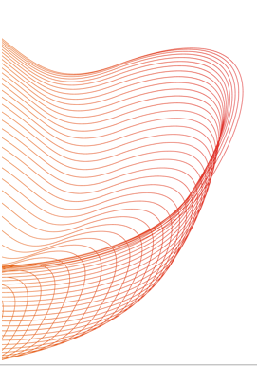
Leveraging Deep Learning and Large Language Models to Extract Directional Drug-Drug Interaction Information
Launch and Learn webinar
Subtitle: A Comparative Study
Hamed Meshkin
January 17, 2025
Notes:
This presentation aims to provide an in-depth exploration of the potential of large language models (LLMs) to enhance regulatory processes within the FDA by leveraging advanced NLP techniques. By assessing zero-shot and few-shot learning capabilities, the study highlights how these models can be effectively implemented in secure, local environments for critical tasks such as pharmacokinetic drug-drug interaction (PK DDI) detection.

Slide 2
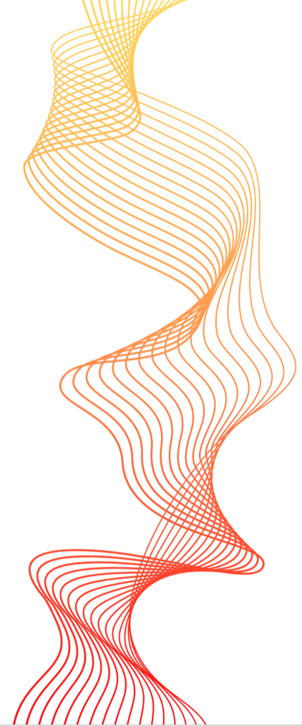
Outline
Goal
Background
BioBert Directional DDI model
In context learning (Few and Zero-shot text classification)
Model Evaluation
Summary
Notes:
Goal: Overview of the primary objectives and specific tasks to be addressed by the LLMs.
Background: Introduction to the motivation behind using LLMs, the evolution of NLP techniques, and existing challenges.
BioBERT Directional DDI Model: Summary of critical insights, model performance metrics, and practical implications from prior research. Which includes Detailed examination of the fine-tuned BioBERT model used in earlier work, including its approach and outcomes.
Few and Zero-Shot Learning: Explanation of these learning paradigms, their significance, and how they were evaluated.
Model Evaluation: Comprehensive comparison of model performances, including precision, recall, and F1-scores.
Implications and Future Directions: Discussion on the practical applications, challenges, and potential future developments of deploying LLMs in regulatory settings.

Slide 3
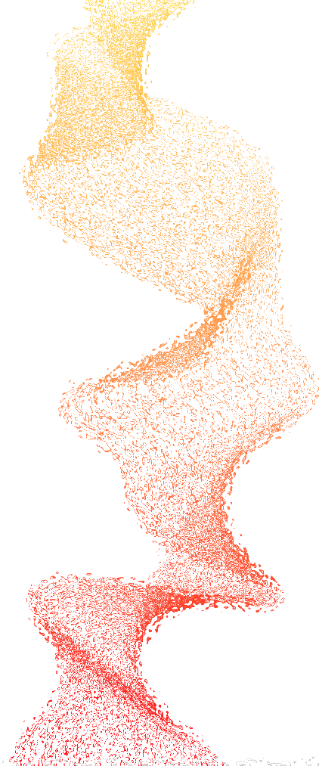
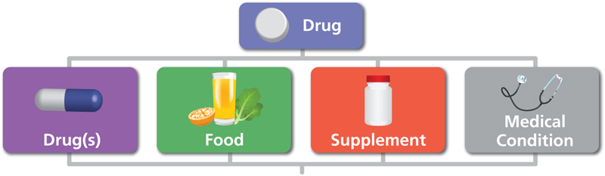
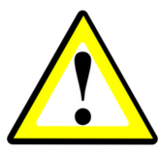
Goal: Extraction of Pharmacokinetic Insights and Biomedical Factor
Extract critical biomedical data, including pharmacokinetic drug-drug interactions, object and precipitant drugs, and intrinsic factors, from literature using locally hosted Large Language Models (LLMs).
Implement secure, locally hosted Large Language Models (LLMs) to automate extraction and classification of interaction data while ensuring data privacy
Pharmacokinetic Drug-Drug Interaction (PK-DDI)
Object?
Precipitant?
“Because substances in grapefruit juice may inhibit the metabolism of Pimozide by CYP3A4, patients should be advised to avoid grapefruit juice.” [1]
Grapefruit juice is the precipitant Pimozide is the object drug
“Following a single 20 mg oral Zolpidem tartrate dose, mean C max and AUC were found to be two times and five times higher, respectively, in hepatically-compromised patients.” [1]
Intrinsic factors?
Zolpidem's clinical exposure have been impacted by Intrinsic factors of liver diseases.
[1] https://dailymed.nlm.nih.gov/dailymed/fda
Notes:
The primary goal of this research is to implement a system that can automatically extract various types of biomedical data from literature using secure, locally hosted Model. These models are designed to classify and retrieve information while ensuring data privacy a critical aspect for regulatory applications.
On this slide, I’ve illustrated three key examples of the types of data our models aim to extract:
Pharmacokinetic Drug-Drug Interaction (PK-DDI): In the first example, substances in grapefruit juice inhibit the metabolism of Pimozide, resulting in altered drug exposure. Here, grapefruit juice is identified as the precipitant, and Pimozide as the object drug. Accurately identifying such interactions can help in clinical decision-making and dosage adjustments.
Object and Precipitant Drug Identification: Beyond simply detecting the presence of interactions, it’s crucial to classify which drug acts as the object and which one acts as the precipitant. This differentiation is vital for understanding the nature of drug interactions and their clinical implications.
Intrinsic Factors Affecting Pharmacokinetics: The third example focuses on intrinsic factors such as liver function. In patients with hepatic impairment, the pharmacokinetics of Zolpidem are significantly altered, leading to higher drug exposure. Identifying such intrinsic factors helps tailor drug therapy to individual patient characteristics.
By automating the extraction of these types of data, we can support the development of safer and more effective therapeutic products while streamlining regulatory processes.

Slide 4
Introduction
Natural language processing (NLP) methods to automatically extract and process information from biomedical literature
Relationship Extract (RE)
NLP Model to identify PK DDI sentences
Pharmacokinetic drug-drug interaction sentences
Biomedical literature corpus
`
Non-PK DDI
PK DDI
Notes:
Extracting drug-drug interaction information manually from biomedical literature is not only time-consuming but also prone to human error. Hence, there’s a clear need for automation. To address this, we’re using Natural Language Processing (NLP) techniques to automatically extract and classify sentences into pharmacokinetic (PK) and non-pharmacokinetic interactions—a process known as relationship extraction.
This slide presents a schematic overview of how our NLP models work for two core tasks:
Relationship Extraction (RE): The first task involves classifying sentences into PK DDI and non-PK DDI categories. This helps in identifying whether a sentence describes a drug-drug interaction that affects pharmacokinetics.

Slide 5
Introduction
Natural language processing (NLP) methods to automatically extract and process information from biomedical literature
Relationship Extract (RE)
NLP Model to identify PK DDI sentences
NLP Model to identify Precipitant and object drugs
Pharmacokinetic drug-drug interaction sentences
Biomedical literature corpus
Pharmacokinetic drug-drug interaction sentences
PK DDI
Notes:
[]
Named Entity Recognition (NER): The second task involves identifying the specific drugs involved in the interaction by determining which drug is the precipitant and which is the object. For example, if Drug A increases the exposure of Drug B, Drug A is the precipitant, and Drug B is the object.
To set up these models, we have two approaches:

Slide 6
Introduction
Natural language processing (NLP) methods to automatically extract and process information from biomedical literature
Relationship Extract (RE)
NLP Model to identify PK DDI sentences
Pharmacokinetic drug-drug interaction sentences
Biomedical literature corpus
PK DDI
Name Entry Recognition (NER)
NLP Model to identify Precipitant and object drugs
Pharmacokinetic drug-drug interaction sentences
Precipitant and object drug
1) Traditional Machine Learning
2) Pre-trained Transformer base Large Language models (LLM)
Notes:
To set up these models, we have two approaches:
Traditional Machine Learning: In this approach, we manually train the model using labeled data, where it learns the relationship between different words.
Pre-trained Transformer-Based LLMs: Alternatively, we can leverage pre-trained transformer models, which already understand complex language patterns. These models only require fine-tuning on specific biomedical tasks, making them faster and more efficient to implement.
By following this approach, we aim to automate the extraction of pharmacokinetic interaction data with greater accuracy and efficiency, significantly reducing the manual workload.

Slide 7
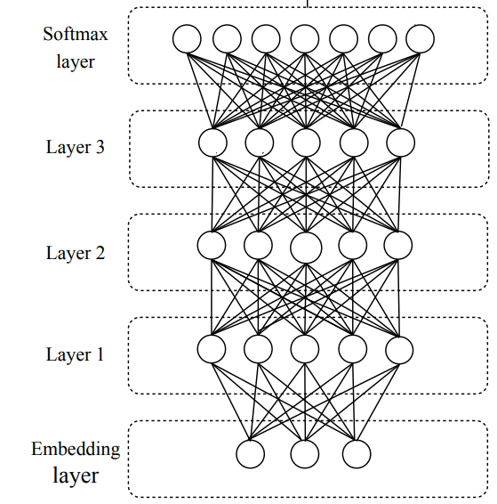
Background: traditional NLP vs Large Language Models
1) Traditional Neural Network
Disadvantages
Training is slow and computationally expensive.
Long sequences cause vanishing gradients, leading to loss of word relationships
Pre-trained models drastically reduce training time.
It can identify complex relationships in longer sequences through attention mechanisms. (the bigger the model, the longer sequence and relationship one can process)
Advantages
Fine-tune an LLM model
2) Pre-trained Transformer base LLMs
In-context learning
(Zero or few-shot learning)
Notes:
Over the years, NLP has evolved from traditional rule-based systems to machine learning models and, more recently, to advanced transformer-based architectures. Let’s start by understanding why traditional neural networks are less effective for tasks like ours.
Traditional neural networks have two major limitations:
Slow Training: Training these models requires large datasets and extensive computational resources, making the process slow and inefficient.
Vanishing Gradient Problem: When dealing with long sequences, traditional neural networks often lose the relationship between distant words. For example, in a long sentence, the connection between the first and last word may be lost, making it difficult for the model to capture context accurately.
Now, let’s compare this to pre-trained transformer-based models, which leverage the attention mechanism. Imagine you’re given a book and asked to answer a question about pharmacokinetic drug-drug interactions. You have two options:
You could read the entire book from cover to cover, which might take a week and result in vague answers.
Or, you could go straight to the index, find the relevant chapter, and extract only the necessary information in a few minutes.
Clearly, the second approach is more efficient and accurate. This is how transformer-based models work—they focus on relevant parts of the input using attention mechanisms, enabling faster and more precise information extraction.
To use a transformer-based LLM, we have two main options:
Fine-tuning: Even though the model is pre-trained, we can fine-tune it for a specific task by adjusting its parameters. This is similar to additional training but requires far fewer resources.
In-context Learning (Zero or Few-Shot Learning): With very large language models, we can use zero-shot or few-shot learning, where the model performs tasks with minimal or no labeled data. This drastically reduces the need for large datasets and makes the model adaptable to a variety of new tasks.
In summary, transformer-based models and LLMs offer significant advantages over traditional neural networks by enabling faster training, better handling of long sequences, and the ability to perform zero-shot or few-shot learning.

Slide 8
Prior study: BioBert Fine-tuning
BioBERT = Pre-trained BERT + Additional pre-training on biomedical data
BioBert model pre-trained with PubMed
Bert
325 structured product tables
(Pre-specified by TAC2019)
PubMed abstracts
PMC full-text articles
21593 annotated sentences
Fine-Tuning
Model Training
13B words
BioBert Directional DDI model¹
BioBert 340M parameters
81 structured Product labels
(Pre-specified by TAC2019)
10592 unannotated sentences
Predict precipitant and object drugs in pharmacokinetic DDIs
Model Validation
Relationship Extract (RE)
Named Entry Recognition (NER)
QA
Evaluate Performance
1. Zirckle et.al (2023) Deep Learning-enabled Natural Language Processing to Identify Directional Pharmacokinetic Drug-Drug Interactions. (under publication)
Notes:
This slide highlights the work done in our previous project led by our colleague Joel Zirkle, which focused on fine-tuning a pre-trained BioBERT model for pharmacokinetic drug-drug interaction (PK-DDI) extraction.
BioBERT, a language model trained on 13 billion words from PubMed abstracts and PMC full-text articles, has 340 million parameters, making it highly suitable for tasks such as relationship extraction, named entity recognition (NER), and question answering. In this project, we fine-tuned BioBERT specifically for identifying PK-DDI sentences and distinguishing between object drugs and precipitant drugs.
Here, the diagram illustrates the complete process:
Fine-Tuning: We fine-tuned the pre-trained BioBERT model using 325 structured product tables provided by the FDA, resulting in a custom model known as the BioBERT Directional DDI model.
Model Validation: The fine-tuned model was then tested and validated using 81 structured product labels, ensuring robust performance across a variety of scenarios.

Slide 9
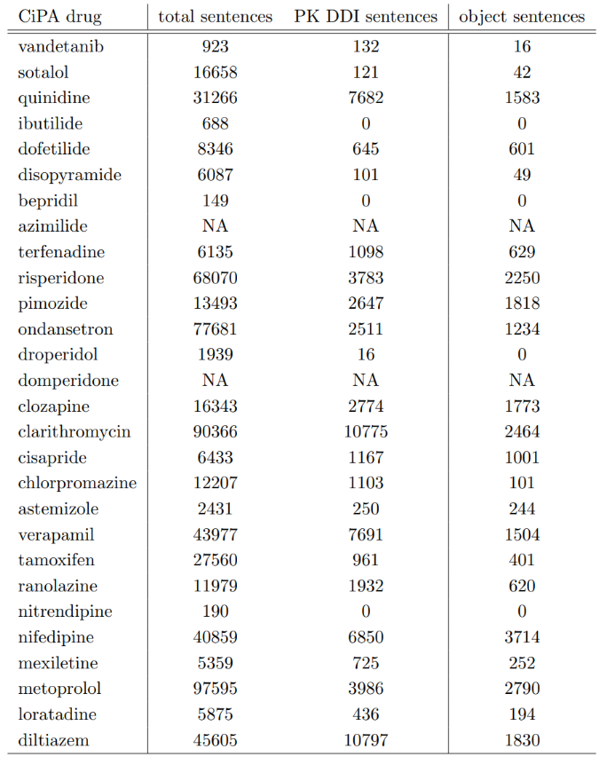
Prior study: BioBert Fine-tuning
Real world problem
Recall | 80.6 %
Precision | 82.7%
F-score | 81.6%
From a list of 28 drugs from the Comprehensive in vitro Proarrhythmia Assay (CiPA) Initiative.
Performance of the sentence classification step.
 | Object | Precipitant
Recall | 93.7% | 94.6%
Precision | 100% | 100%
F-score | 96.8% | 97.2%
Performance of the named entity recognition step
1. Zirckle et.al (2023) Deep Learning-enabled Natural Language Processing to Identify Directional Pharmacokinetic Drug-Drug Interactions. (under publication)
Notes:
The key results from this fine-tuned model include:
Sentence Classification: The model achieved a precision of 82.7%, a recall of 80.6%, and an F-score of 81.6% for identifying PK-DDI and non-PK-DDI sentences.
Named Entity Recognition (NER): For the task of identifying object and precipitant drugs in PK-DDI sentences, the model achieved 100% precision for both types of entities, with F-scores of 96.8% for object drugs and 97.2% for precipitant drugs.
These metrics demonstrate the high reliability of the fine-tuned BioBERT model for automatically extracting directional pharmacokinetic drug-drug interaction information from biomedical text. Such automation is crucial for efficiently gathering clinical exposure data, which plays a significant role in drug development and regulatory review processes.
In a later phase, we applied the BioBERT Directional DDI model to analyze sentences from FDA labels as part of the Comprehensive in vitro Proarrhythmia Assay (CiPA) initiative, identifying PK-DDI relationships in over 46,000 sentences extracted from FDA drug labels.”

Slide 10



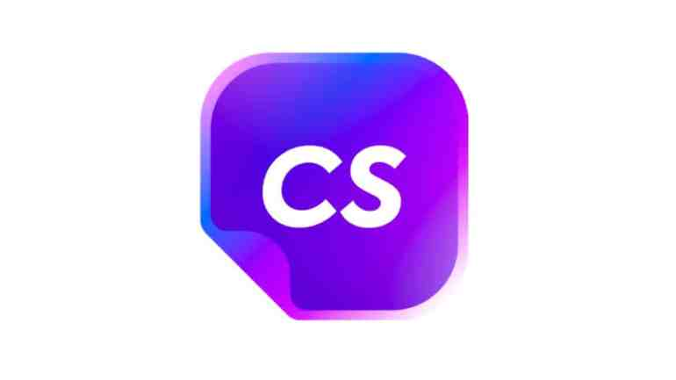



2. Follow-Up Study: In-context learning
ChatGPT
Google Bard
Perplexity AI
Jasper AI
Claude
Chat Sonic
Objectives
One can use our previous technique, HOWEVER, for any task we need to prepare sufficiently large training/validation dataset and consequently fine-tun the model
One can use one of these online sources, HOWEVER, there is a risk of data leakage associated with the utilization of online platforms
Implement a ChatGPT-like model throughout the FDA network
Notes:
For our follow-up study, we explored a different approach: in-context learning using large language models. Currently, several prominent companies and research groups are actively developing large language models capable of performing advanced AI tasks without the need for fine-tuning. Every day, numerous platforms and tools are launched, offering a wide range of AI-driven solutions.
Here, we highlight some of the most widely known models, such as ChatGPT, Google Bard, and Claude. While these models provide impressive capabilities, using external online sources poses significant risks, particularly regarding data privacy and leakage—a critical concern in regulatory and clinical settings.
Moreover, while our previous BioBERT-based model remains useful, it requires fine-tuning for every new task, which can be resource-intensive. These factors collectively motivated us to develop a ChatGPT-like model deployed entirely within the FDA network, ensuring both data security and flexibility for various PK-DDI extraction tasks."

Slide 11
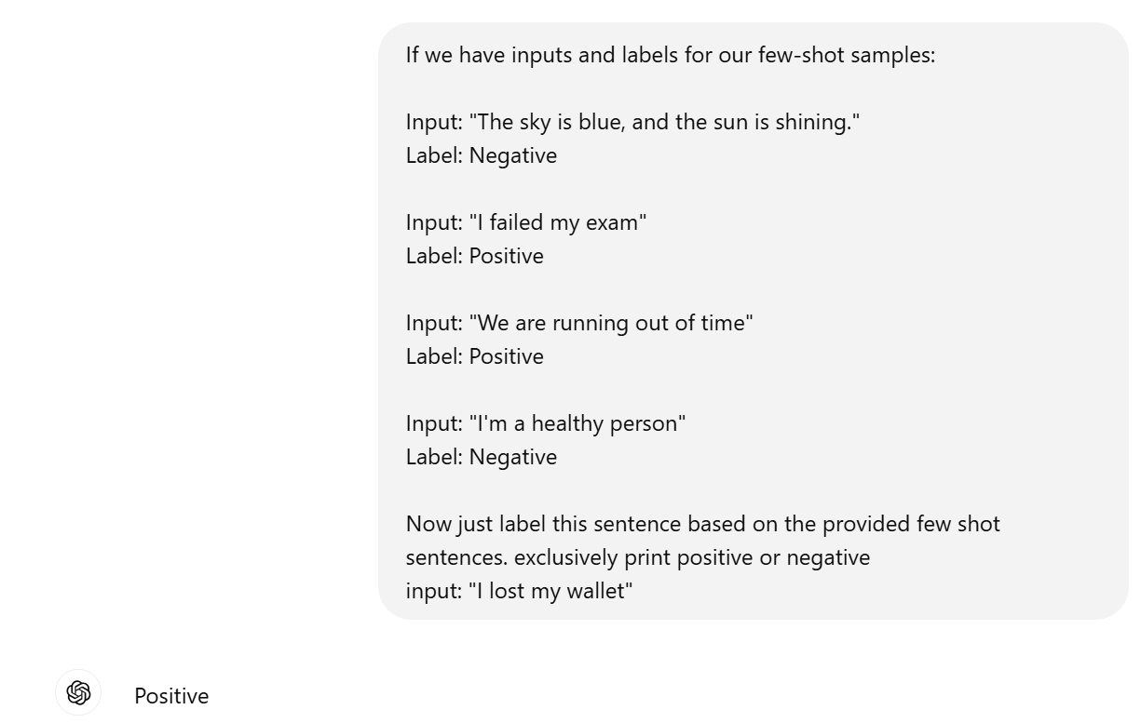
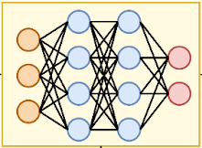
Few/Zero shot text classification
Transformer Model
Large Labeled Dataset
Using Few-Shot learning to train ChatGBT
Few-shot learning
Example 1: PK DDI sentence Example 2: PK DDI sentence
Example 3: Non-PK DDI sentence Example 4: Non-PK DDI sentence
Query set Prediction
Pre-processing
Model Inference
Prompt Query + (sentences set)
Tokenization
Post-Processing
Few-shot learning (FSL) practice of feeding a machine learning model with a very small amount of training data to guide its predictions
Notes:
This slide illustrates the workflow of a transformer-based large language model (LLM) applied for few-shot learning. In few-shot learning, we introduce a small amount of labeled training data to guide the model's predictions. For our case, we fed the LLM with 4 labeled sentences: two describing pharmacokinetic drug-drug interactions (PK-DDI) and two describing non-PK DDI sentences. These examples, along with validation sentences, are provided in the form of a prompt question to the model.
Before the model can make predictions, the input data undergoes two key preprocessing steps:
1.Preprocessing: The input sentences and the prompt are tokenized and encoded, converting them into a numerical format suitable for the model.
Model Inference: The encoded input is processed by the LLM to generate predictions.
Tokenization: Breaking down the input text into smaller units (tokens) for the model to process.
Encoding: Converting these tokens into a numerical format that the model can understand.
Postprocessing: The output is decoded to determine whether the provided sentence describes a PK-DDI or a non-PK DDI interaction.
The processed input, along with the prompt, is then passed through the model's inference pipeline. Finally, during the postprocessing phase, the model decodes its predictions to determine whether the given sentence pertains to a PK-DDI or non-PK DDI interaction.
This approach demonstrates the power of transformer-based LLMs to make accurate classifications even with minimal labeled data, leveraging the model's pre-trained knowledge and adaptability.

Slide 12


FSL
Large data collection
Example 1: PK DDI sentence Example 2: PK DDI sentence
Example 3: Non-PK DDI sentence Example 4: Non-PK DDI sentence
+
Prompt + (sentences set)
FSL input
Query set Prediction
Pre-processing
Model Inference
ZSL input
ZSL
Tokenization
Post-Processing
Prompt + (sentences set)

Slide 13

Few/Zero shot text classification
Transformer Model
Flan-T5-XXL
Tk-instruct
T0PP
Vicuna
BioBert
Large Labeled Dataset
Large language transformer Models
Zero-shot learning
Query set Prediction
Prompt Query + (sentences set)
Pre-processing
Hugging Face
Model Inference
Tokenization
Post-Processing
Zero-shot learning (ZSL) is a Machine Learning paradigm that introduces the idea of Query samples with class labels that were never observed during the initial training phase
Notes:
In this slide, we focus on zero-shot learning, which allows the model to make predictions without being trained on labeled examples for a specific task. Unlike few-shot learning, where a small set of labeled data is provided, zero-shot learning relies solely on the model’s pre-trained knowledge and a well-crafted prompt query to perform classification tasks.
The process remains mostly the same, involving:
Preprocessing: The input sentence and the prompt are tokenized and encoded.
Model Inference: The model processes the encoded input and generates predictions.
Postprocessing: The output is decoded to determine whether the input sentence is related to a PK-DDI or non-PK DDI interaction.
On the right side of the slide, we’ve listed several pre-trained transformer models that we used during our validation process:
FLAN-T5-XXL
Tk-Instruct
T0pp
Vicuna
BioBERT
These models are all accessible via the Hugging Face platform, which provides a centralized repository for a wide variety of pre-trained models. During our project, we evaluated these models to identify which one delivered the best performance for our task, specifically in classifying pharmacokinetic interactions.
The advantage of zero-shot learning is that it significantly reduces the need for large annotated datasets, enabling quick adaptation to new tasks by leveraging the general knowledge embedded in these large language models.

Slide 14
Large Language Transformer Models
Model | Parameter size | Trained source | Strengths | Weaknesses
Tk-Instruct | 137B | Dataset of text and code from a variety of sources, including books, articles, code repositories, and conversations. | Following instructions, completing requests thoughtfully | Can be slow and computationally expensive
Flan-T5-XXL | 11B | Massive dataset of text and code, including books, articles, code repositories, and conversations. | General-purpose LLT, good at tasks that require general knowledge | Can be slow and computationally expensive
T0pp | 6.7B | Dataset of text and code from a variety of sources, including books, articles, code repositories, and social media. | Text classification, sentiment analysis, question answering | Not as good at tasks that require following instructions as Tk-Instruct
Vicuna | 1370B | Dataset of code from GitHub | Code generation, understanding and translating code | Not as good at general-purpose NLP tasks as Flan-T5-XXL
ChatGPT3 | 175B | Dataset of text and code from a variety of sources, including books, articles, code repositories, and conversations. | Conversational AI, chatbots | Can be less informative than other LLT models
BioBERT | 0.34B | Dataset of biomedical text, including clinical notes, research papers, and drug labels. | Biomedical NLP tasks such as clinical text processing and drug discovery | Not as good at general-purpose NLP tasks as other LLT models
Notes:
This table presents a comparison of various Large Language Models (LLMs) based on their parameter size, training data sources, strengths, and weaknesses. I generally avoid including wordy tables in slides, but in this case, it helps provide a quick overview, allowing us to focus on the key differences.
Let’s go through some key points, focusing on the blue section for parameter size. As you can see, there’s a significant variation in the models’ sizes and capabilities. The differences in parameter size are primarily influenced by the amount and type of data used for training, as well as the specific architecture of the models.
For example:
BioBERT, which has 340 million parameters, is the smallest model listed here. Since it was pre-trained specifically on biomedical text, it performs well in domain-specific tasks like biomedical NLP but often requires fine-tuning to improve its performance further on specialized tasks.
On the other hand, we have Vicuna, the largest model on this list, with 1.37 trillion parameters. Its large size and extensive training data make it highly capable in tasks requiring code understanding, translation, and general-purpose NLP tasks.
Understanding these differences is important because the choice of model can impact performance, resource requirements, and suitability for specific tasks. While smaller models like BioBERT are efficient for specialized domains, larger models like Flan-T5-XXL and Vicuna excel in general-purpose tasks but may require significant computational resources.
In our project, we evaluated several of these models, including FLAN-T5-XXL, Tk-Instruct, T0pp, Vicuna, and BioBERT, to determine which one offers the best balance of accuracy and efficiency for pharmacokinetic drug-drug interaction extraction.

Slide 15
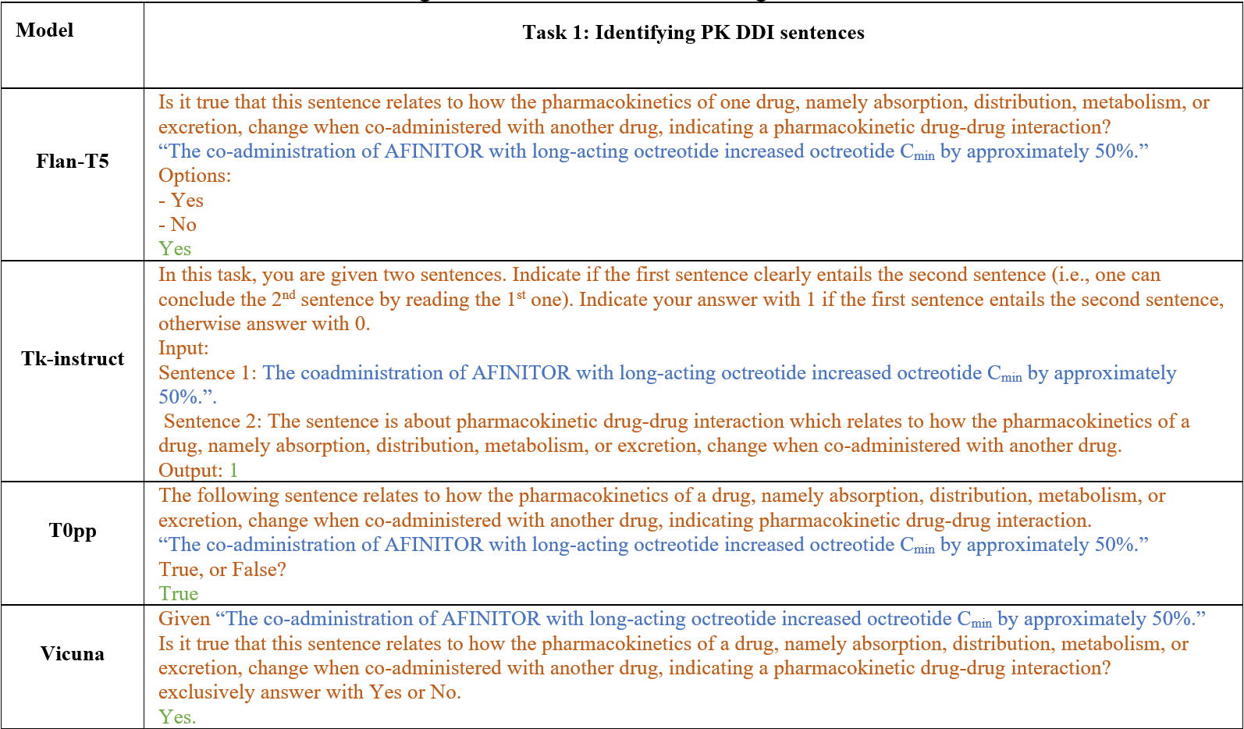
Prompt Question: PK-DDI
Notes:
This slide presents the prompts we used for evaluating each large language model (LLM) during the classification of pharmacokinetic drug-drug interaction (PK-DDI) sentences.
What you see here are the prompts fed into different models. Based on the model developers’ recommendations, we tested a unique prompt format for each model to achieve the best performance. Specifically:
Blue text: These are the sentences extracted directly from FDA drug labels, which describe a potential PK-DDI.
Red text: This represents the prompt question given to the model, instructing it to identify whether the sentence describes a pharmacokinetic drug-drug interaction.
Green text: This is the model’s output or the classified label, indicating whether the sentence is a PK-DDI or not.
Let’s take the first example with Flan-T5:
The sentence extracted from the drug label is: “The co-administration of AFINITOR with long-acting octreotide increased octreotide Cmin by approximately 50%.”
The prompt asks the model: “Is it true that this sentence relates to how the pharmacokinetics of one drug, namely absorption, distribution, metabolism, or excretion, change when co-administered with another drug?”
The model outputs ‘Yes’, correctly identifying that this sentence describes a PK-DDI.
During our performance evaluation, we noticed that using prompts with detailed explanations of what constitutes a PK-DDI led to better results. Therefore, we decided to include a short description in each prompt to guide the model more effectively. This adjustment helped improve the model’s ability to classify PK-DDI sentences accurately.
Overall, this approach illustrates the importance of prompt engineering in zero-shot and few-shot learning scenarios, as the format and content of the prompt can significantly influence model performance.

Slide 16
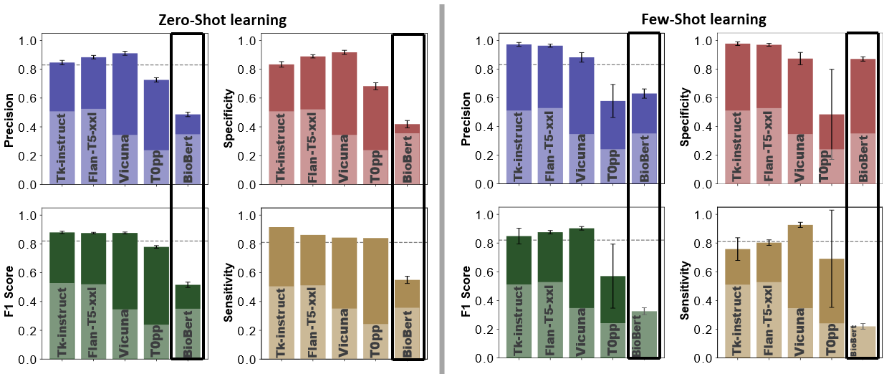
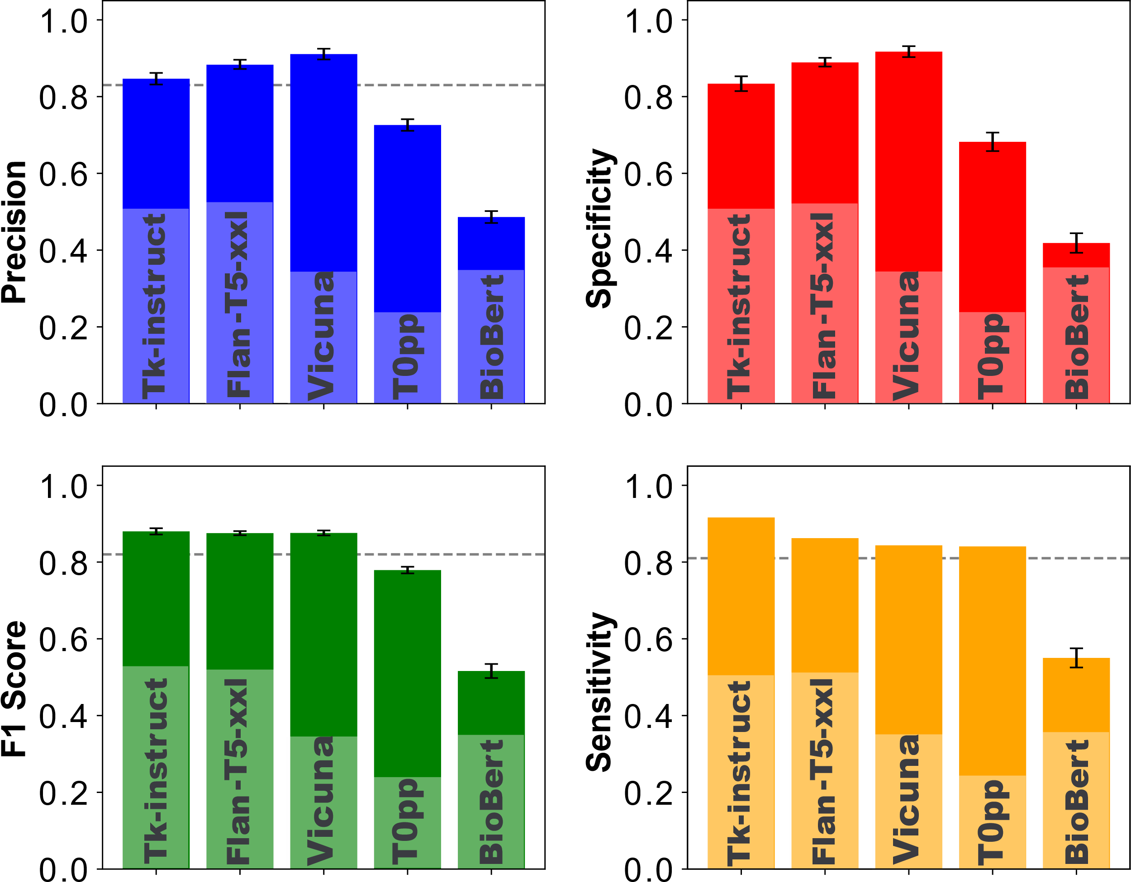
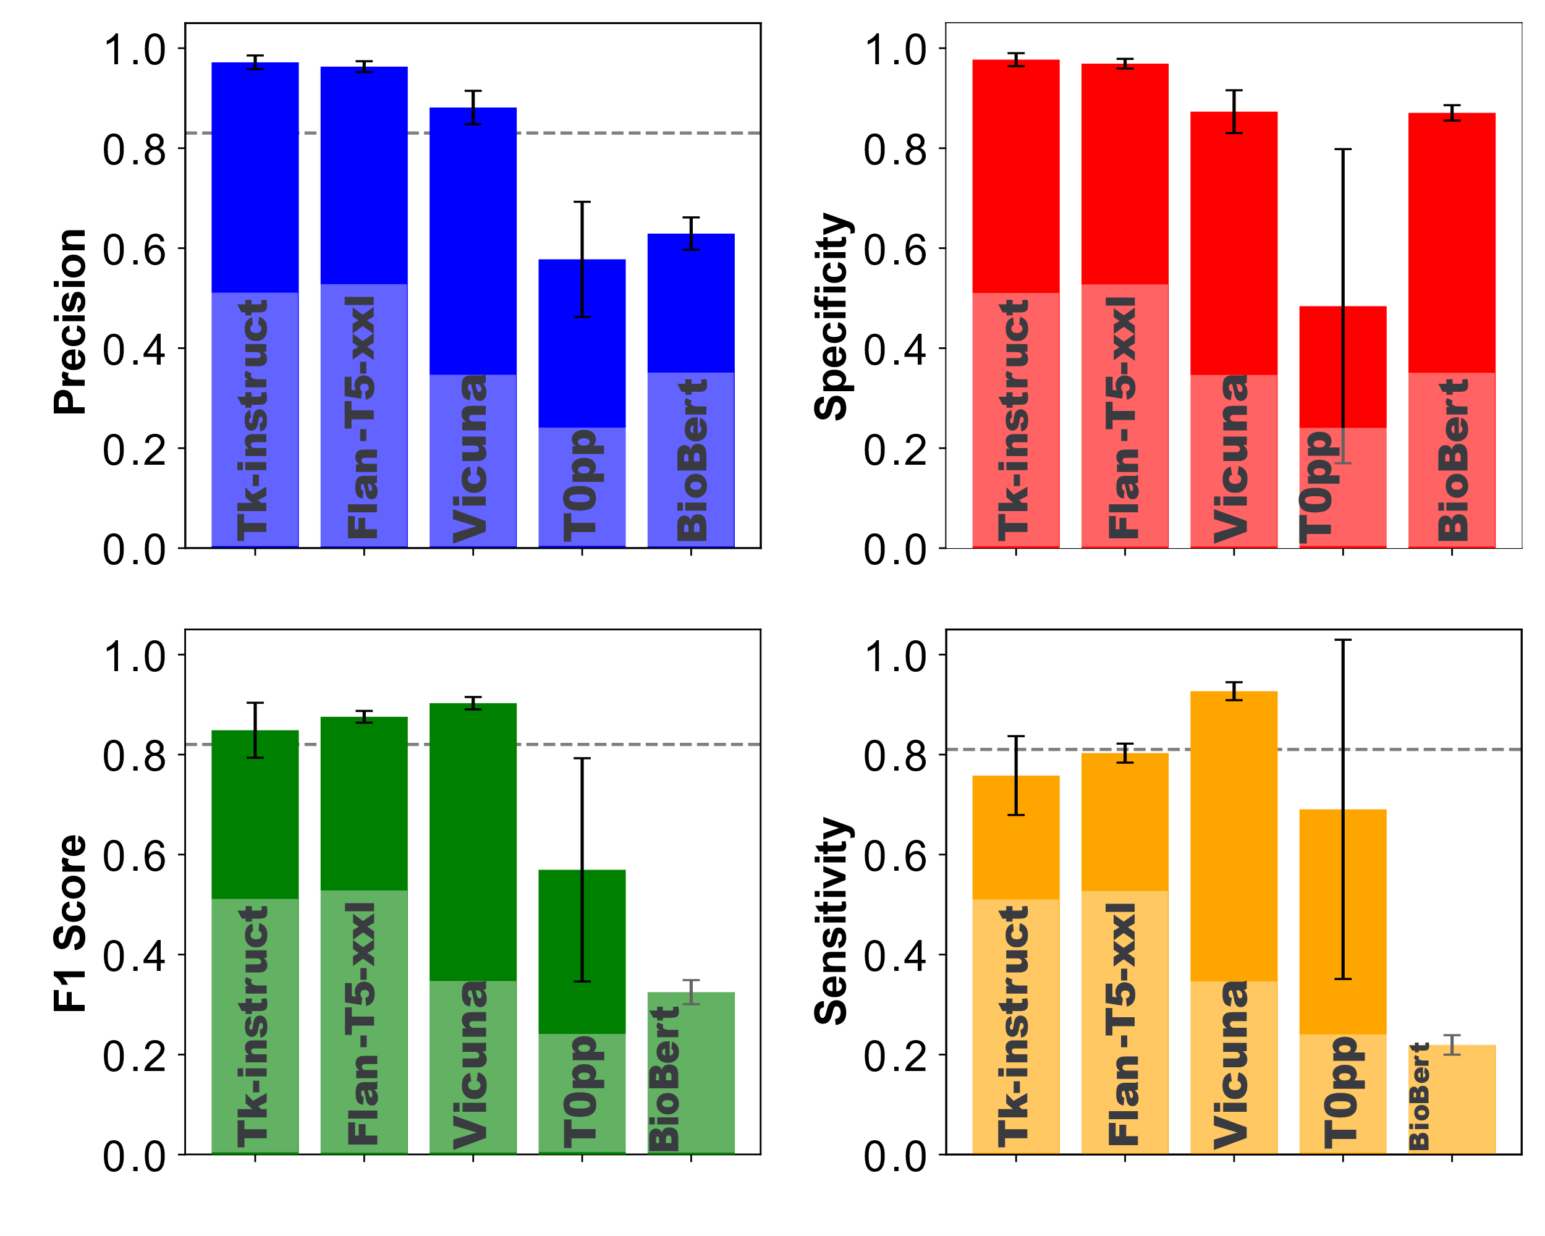
Model Evaluation: PK-DDI vs non PK-DDI
BioBert model fine-tuned by 21593 (PK DDI and Non-PK DDI) sentences.
Zero and Few-shot learning evaluated by 10242 (PK and Non-Pk DDI) sentences
Then evaluated through 10592 sentences
Fine-tuned BioBert model
Zero-Shot learning
Few-Shot learning
Notes:
Here we, summarizes the PK-DDI evaluation results by comparing the performance of different models, including our fine-tuned BioBERT model from the prior research and various large language transformer models evaluated using zero-shot and few-shot learning.
Fine-Tuned BioBERT:
The fine-tuned BioBERT model was evaluated on 10,592 sentences, achieving over 80% precision, recall, and F-score across all metrics. This suggests that approximately 80% of the sentences were correctly classified as PK-DDI or non-PK DDI.
This result highlights the effectiveness of fine-tuning BioBERT specifically for pharmacokinetic tasks.
Zero-Shot and Few-Shot Learning with Large LLMs:
We evaluated the large language models (Flan-T5-XXL, Tk-Instruct, Vicuna, T0pp, and non-fine-tuned BioBERT) on 10,242 sentences. The performance varied across models, and we measured key metrics such as precision, F-score, sensitivity, and specificity.
Notably, the non-fine-tuned BioBERT model resulted in the lowest evaluation metrics, emphasizing the importance of fine-tuning for improved performance in specialized tasks.
Few-Shot Learning Evaluation:
For few-shot learning, we varied the few-shot examples and averaged the results across different sample sets. This approach resulted in error bars on the graphs, indicating variability in performance depending on the specific few-shot examples used.
The error bars show that, in some cases, certain few-shot examples improved model performance, while others led to a decrease. This underscores the critical role of prompt design and example selection in few-shot learning.
Key Observations:
For both zero-shot and few-shot learning, models like Tk-Instruct, Flan-T5-XXL, and Vicuna consistently delivered high performance, achieving more than 90% precision and specificity.
T0pp performed well in zero-shot learning, with metrics between 80% and 90%, but its performance in few-shot learning, particularly for specificity and F-score, was suboptimal.
As expected, the non-fine-tuned BioBERT model performed poorly, reinforcing the need for task-specific fine-tuning to achieve reliable results.
In conclusion, these results demonstrate that fine-tuning models like BioBERT significantly enhances their ability to classify PK-DDI sentences, while transformer-based models like Tk-Instruct, Flan-T5-XXL, and Vicuna can achieve high accuracy in zero-shot and few-shot scenarios when appropriate prompts and examples are used.”

Slide 17
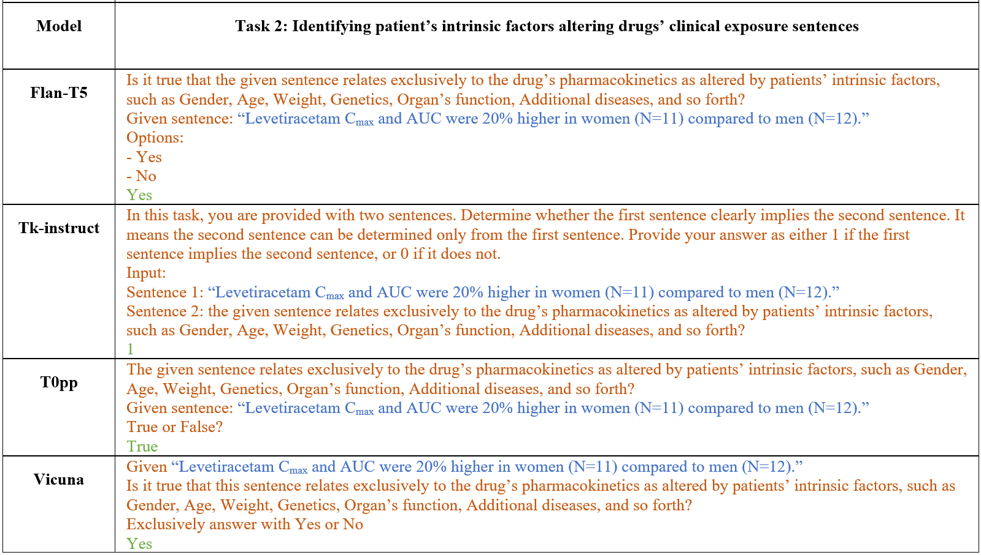
Prompt Questions: Intrinsic factors affecting drug clinical exposure
Notes:
For the second task, instead of identifying object and precipitant drugs in drug-drug interactions, we focus on identifying how patient’s intrinsic factors—such as age, race, weight, gender, genetics, and organ function—can affect the clinical exposure of a drug (object drug). In this context, the precipitant is not another drug or compound but rather intrinsic factors that can alter the drug's pharmacokinetics.
What you see here is the set of prompts we used for different models to classify sentences that describe intrinsic factors influencing drug exposure. Based on the model developers’ recommendations, we designed a unique prompt for each model to optimize performance:
Blue text: These are sentences directly extracted from FDA drug labels, describing potential intrinsic factors affecting drug pharmacokinetics.
Red text: This represents the prompt question, guiding the model to identify whether the sentence relates to intrinsic factors.
Green text: This is the model’s output or the classified label, indicating whether the sentence correctly describes intrinsic factors affecting clinical exposure.
Let’s take an example with Flan-T5:
The extracted sentence is: ‘Levetiracetam Cmax and AUC were 20% higher in women (N=11) compared to men (N=12).’
The corresponding prompt asks: ‘Is it true that the given sentence relates exclusively to the drug’s pharmacokinetics as altered by patients’ intrinsic factors, such as gender, age, weight, genetics, organ function, additional diseases, and so forth?’
The model correctly outputs ‘Yes’, indicating that the sentence indeed describes intrinsic factors influencing drug exposure.
Similar to the first task on PK-DDIs, we observed that including a short explanatory detail in the prompt—specifically mentioning the intrinsic factors—helped improve the model’s performance. This further illustrates the importance of carefully crafting prompts to guide models effectively in zero-shot and few-shot learning scenarios.

Slide 18
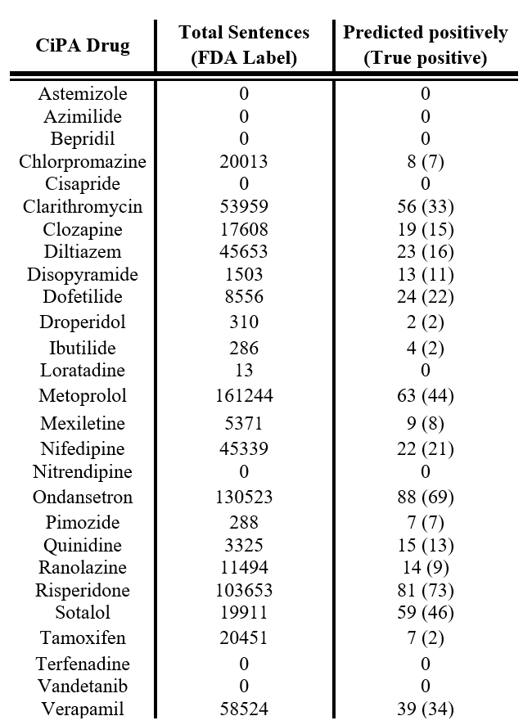
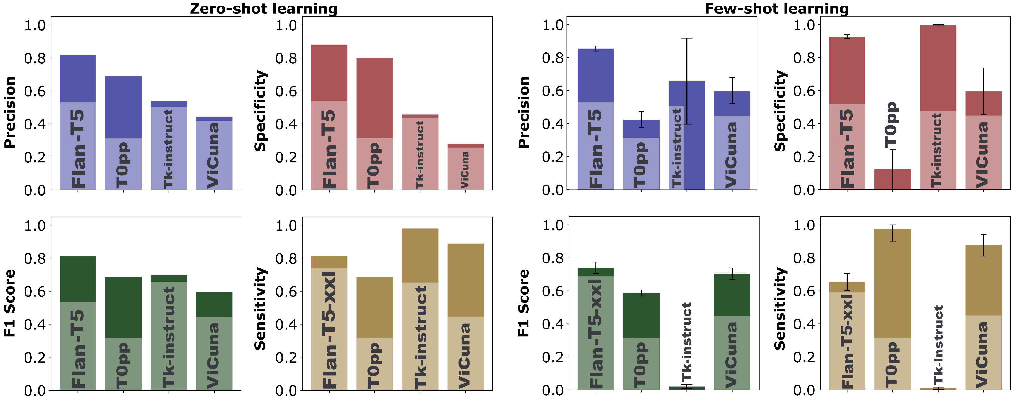
Model Evaluation: Intrinsic factors affecting drug clinical exposure
Real world problem
Zero and Few-shot learning evaluated by 500 sentences For sentence classification task focused on intrinsic factors that affect drug clinical exposure (198 positive and 302 negative sentences)
From a list of 28 drugs from the Comprehensive in vitro Proarrhythmia Assay (CiPA) Initiative. 708,024 sentences being extracted from the labels
precision rate 78.5%
Notes:
This slide presents the results of evaluating zero-shot and few-shot learning models on a sentence classification task focused on identifying intrinsic factors that alter drug clinical exposure. We annotated 500 sentences, consisting of 198 positive as patient’s intrinsic factor affect’s the dlinical pharmacokinetiks and 302 negative sentences.
Model Evaluation Results:
Zero-Shot Learning:
For zero-shot learning, we evaluated models like Flan-T5, T0pp, Tk-Instruct, and Vicuna.
As shown in the graphs, Flan-T5 demonstrated the highest performance in terms of precision, specificity, and F1 score, followed by T0pp.
The models generally exhibited a high degree of variability, indicating that while some models performed well without labeled examples, others struggled in this task.
Few-Shot Learning:
In few-shot learning, we provided a small set of labeled examples to guide the models. Here, Flan-T5 once again achieved the best performance, especially in terms of specificity and F1 score.
We observed that including well-crafted few-shot examples significantly improved the performance compared to zero-shot learning. However, the results varied across different models, as indicated by the error bars.
Real-World Application: CiPA Initiative:
To demonstrate the practical applicability of our approach, we applied it to 28 drugs from the Comprehensive in vitro Proarrhythmia Assay (CiPA) initiative, extracting 708,024 sentences from FDA drug labels.
The right-hand table shows the results, where:
Total sentences represent the number of extracted sentences for each drug.
Predicted positively indicates the number of sentences classified as describing intrinsic factors, with the true positives shown in parentheses.
Overall, our approach achieved a precision rate of 78.5%, which is a promising result given the complexity of the task and the variability of intrinsic factors described in clinical literature.
In conclusion, this evaluation highlights the potential of large language models to automate the extraction of intrinsic factors affecting drug exposure from large-scale biomedical text, supporting real-world regulatory applications.

Slide 19
Summary
Among all tested transformer-based models, Tk-Instruct, Vicuna, and Flan-T5-XXL delivered outstanding performance.
These models stand out because they don’t require fine-tuning, making them easier to implement compared to the fine-tuned BioBERT model.
Both zero-shot and few-shot learning provided excellent performance. Each technique has unique strengths, so it’s recommended to try both approaches for any task, whether using models like ChatGPT or Google BERT in research or daily tasks.
Our results demonstrate the feasibility of implementing a ChatGPT-like model within the FDA network with secure local deployment.
Future Work
LLM Image Processing Capabilities
User-Friendly Interfaces
Real-Time Adaptation
Notes:
Now, let’s quickly summarize our results.
Among all the transformer-based models we tested, Tk-Instruct, Vicuna, and especially Flan-T5-XXL delivered outstanding performance compared to the other models. These models stood out not only because of their high accuracy in both zero-shot and few-shot learning but also due to the convenience they offer. Since they don’t require fine-tuning like BioBERT, their implementation and usage are far more straightforward and efficient.
Both zero-shot and few-shot learning proved capable of providing excellent performance. Therefore, it would not be accurate to claim that one approach is categorically better than the other. In few-shot learning, we guide the model by providing a small set of labeled examples. Meanwhile, in zero-shot learning, the model leverages its pre-trained knowledge without needing any labeled data. Because of their unique strengths, it’s beneficial to explore both techniques for any given task—not just for the models we used in this study, but also for other models, such as ChatGPT or Google BERT, which are commonly used for everyday tasks.
To wrap it up, our results demonstrate that we can successfully implement a ChatGPT-like model within the FDA network, ensuring both high performance and secure local deployment. For future work 1.LLM Image Processing Capabilities: Explore using large language models (LLMs) with the capability to accept and process images. This would enable automated extraction of relevant information from drug labels, clinical charts, and medical images, further supporting regulatory tasks.
User-Friendly Interfaces: Develop user-friendly interfaces to facilitate the adoption of these models by non-technical users, enabling broader application within the FDA network.
Real-Time Adaptation: Investigate real-time learning methods where models can update or refine their knowledge dynamically based on new data without requiring retraining from scratch.

Slide 20
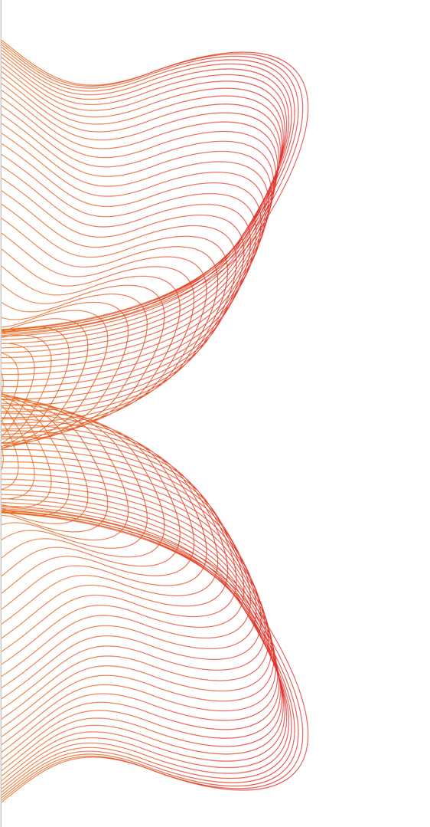
Acknowledgment
DARS Mechanistic Modeling Team
Zhihua Li
John Mann
Joel Zirkle
Shilpa Chakravartula
Anik Chaturbedi
Ghazal Arabidarrehdor
Notes:
I would like to thank Zhihua for the best lead of this project, and anybody on the team they were critical as well.
I would be happy to take any question.

